Slide 1
Final Project
Evgenii Vetoshkin
Ilia Rozhnov

Slide 2
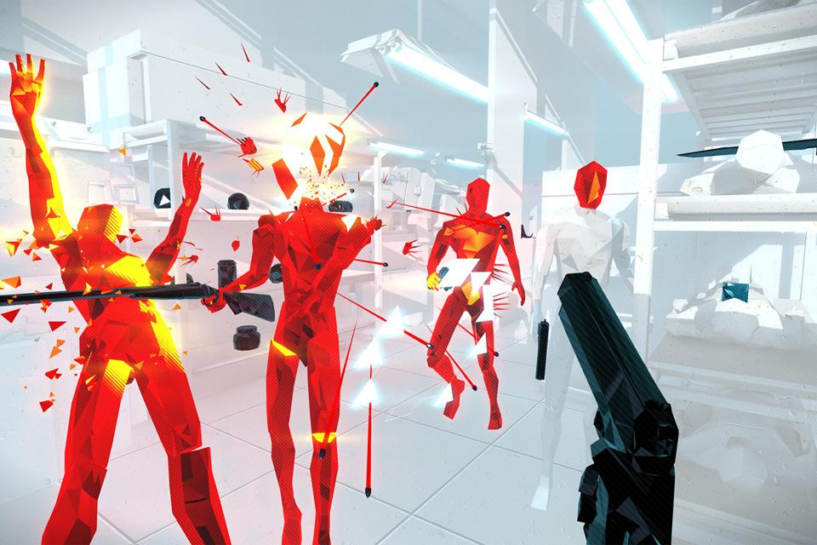
Concept
This VR project is а game where the player stands motionless in one place and shoots back from advancing opponents. The player will need to aim, reload, and use other in-game objects using controllers

Slide 3
Reference
Pistol whip
onward VR

Slide 4
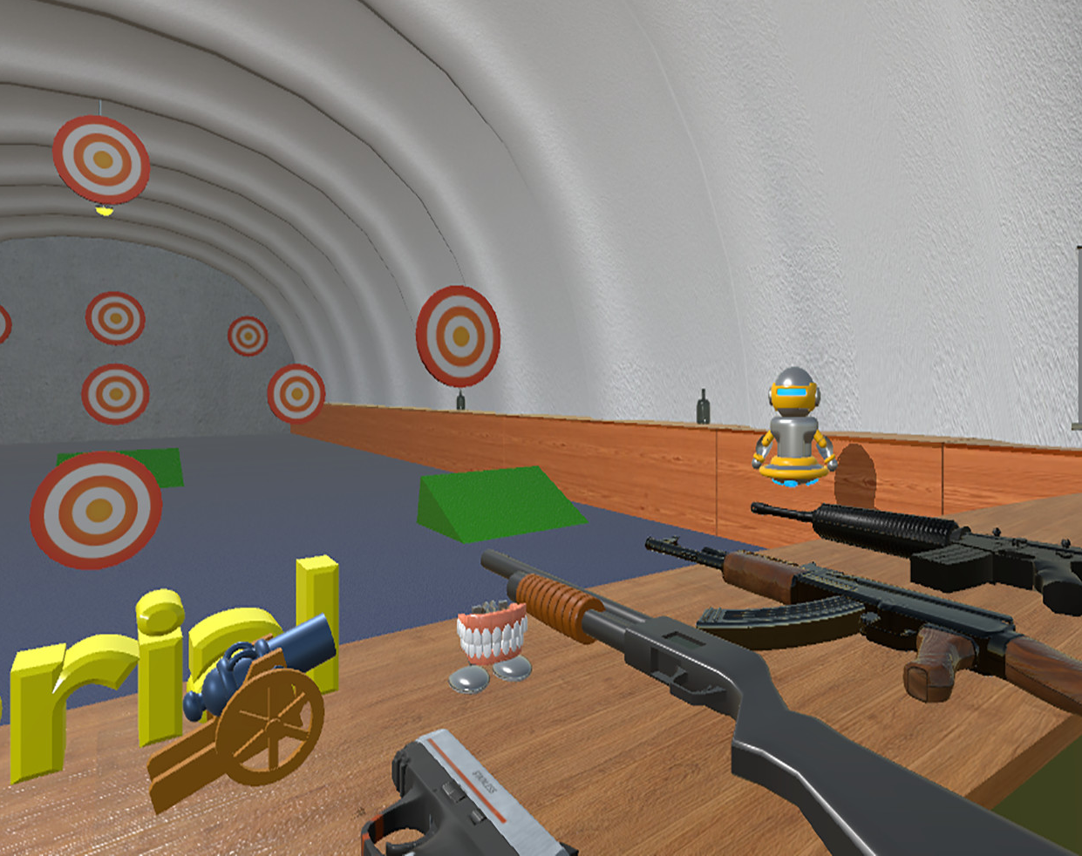
Polygon
A place where you can test all your weapons

Slide 5
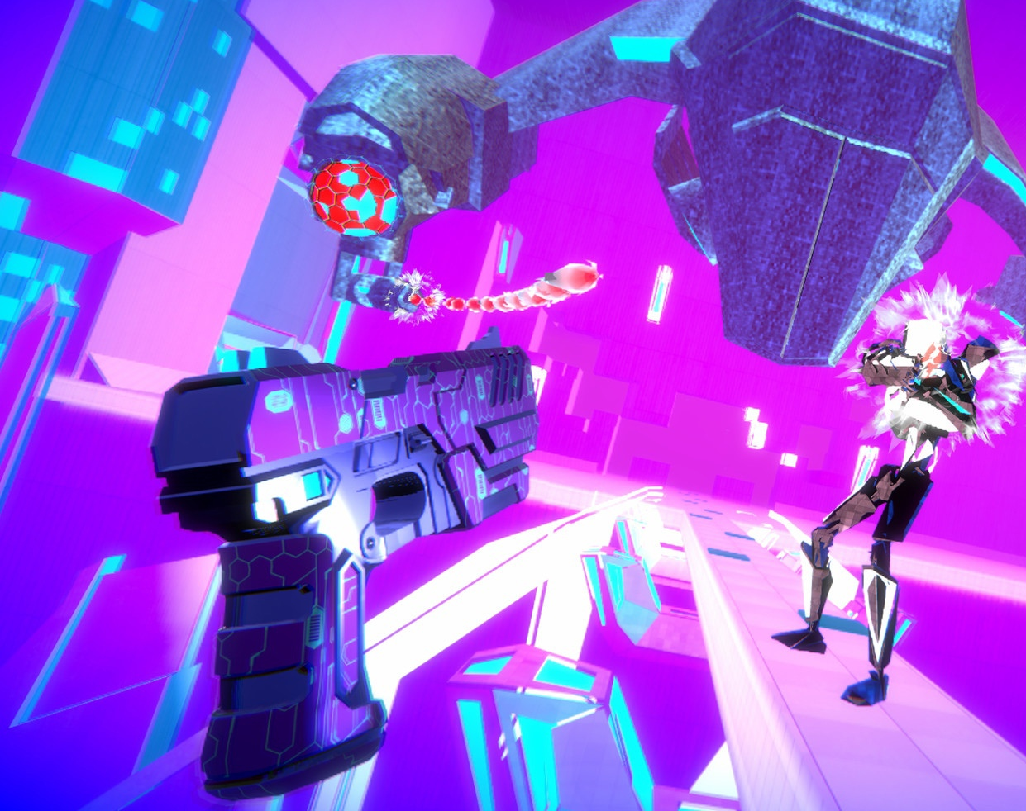
Endless mode
Use chosen weapon to survive as long as you can

Slide 6
Contributers
Evgenii Vetoshkin
Ilia Roshnov

Slide 7
Tools
Unity
GitHub
Adobe Photoshop
Blender

Slide 8
Thank you!

